Slide 1
Navigating the Future of Online Shopping
SQL vs Python — E-Commerce Dataset Analysis
This presentation explores a comprehensive E-Commerce dataset containing over 100,000 orders across 7 interconnected tables — Customers, Orders, Payments, Products, Order Items, Sellers and Geolocation.
The analysis is performed using two powerful approaches:
SQL (MySQL) — for structured database querying
Python (Pandas & Matplotlib) — for data manipulation and visualization
The goal is to extract meaningful business insights across 3 levels of complexity:
Level 1 — Basic Problems : Fundamental insights from the dataset
Level 2 — Intermediate Problems : Deeper sales and order trends
Level 3 — Advanced Problems : Strategic and customer-centric insights
A total of 15 questions are solved and compared side-by-side to validate that both SQL and Python produce matching results.

Slide 2


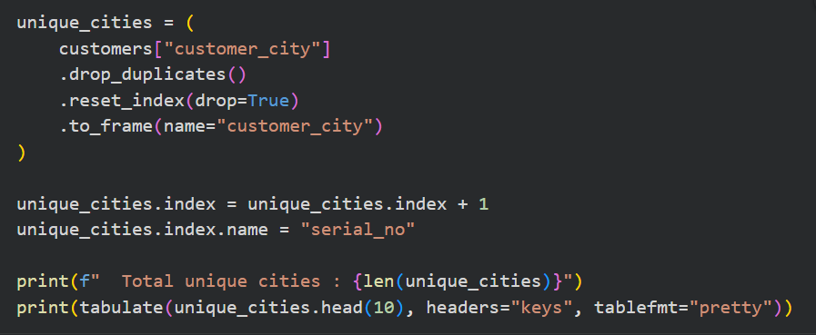

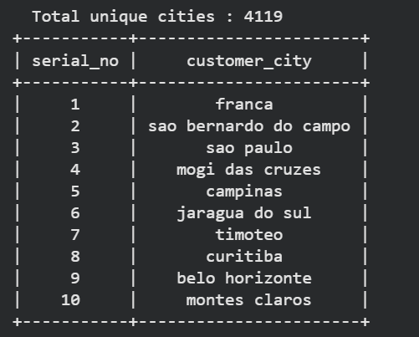
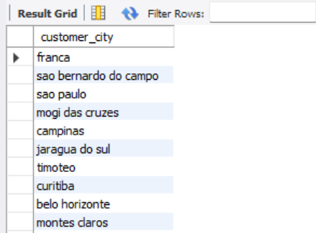
BASIC PROBLEMS
Question 01
List all unique cities where customers are located
Python Code
SQL Query

Slide 3
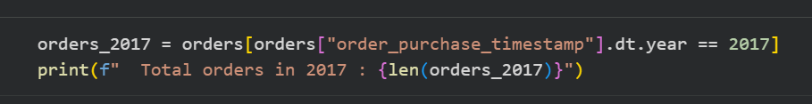
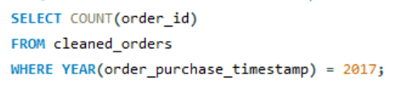

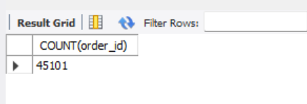
Question 02
Count the number of orders placed in 2017
Python Code
SQL Query

Slide 4
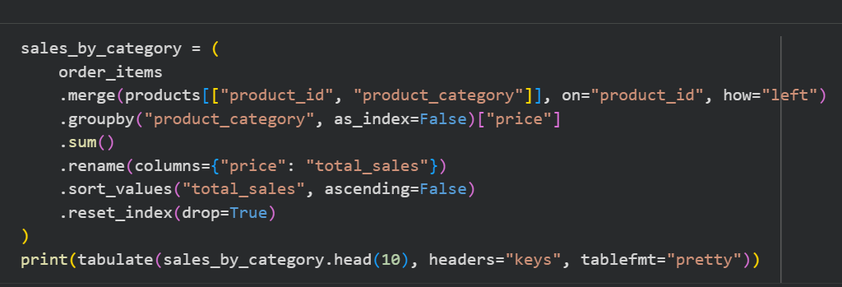
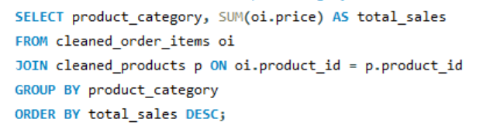
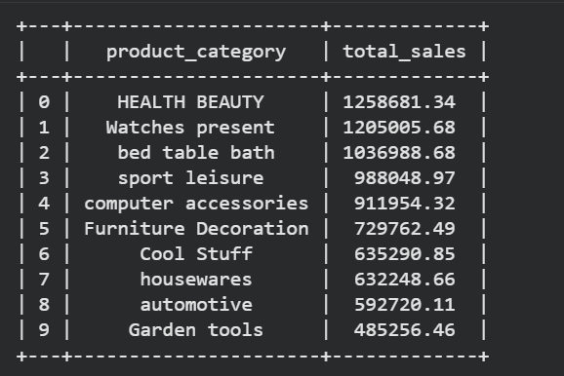
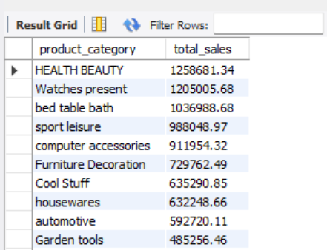
Question 03
Find the total sales per category
Python Code
SQL Query

Slide 5
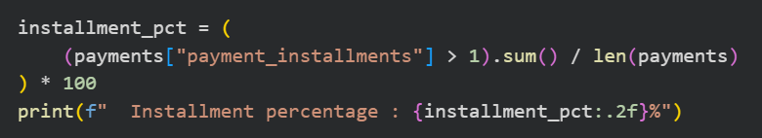
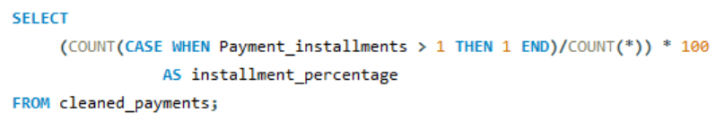

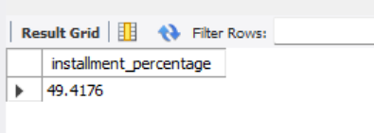
Question 04
Calculate the percentage of orders that were paid in installments
Python Code
SQL Query

Slide 6
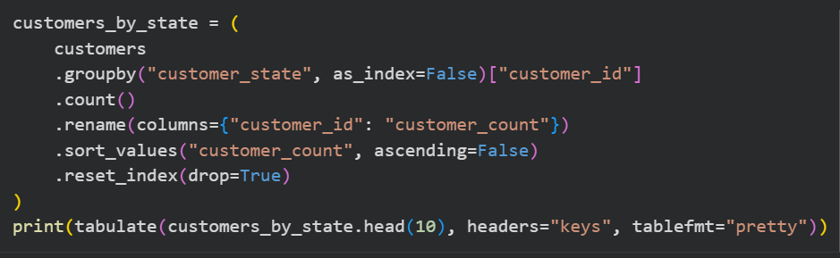
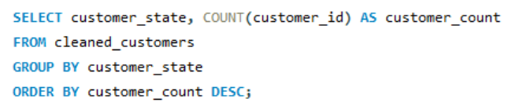
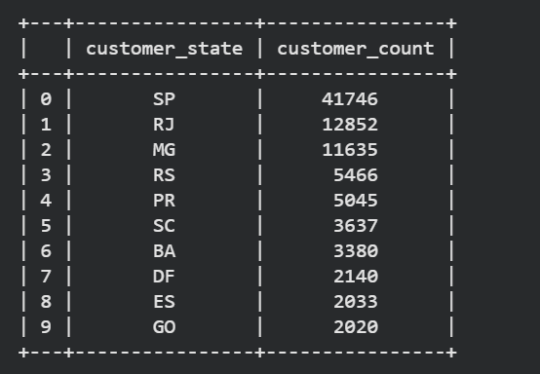
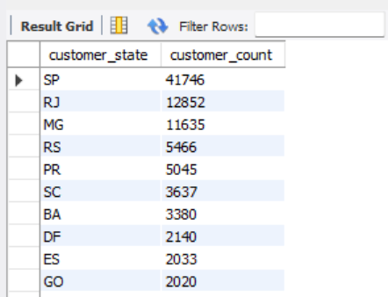
Question 05
Count the number of customers from each state
Python Code
SQL Query

Slide 7
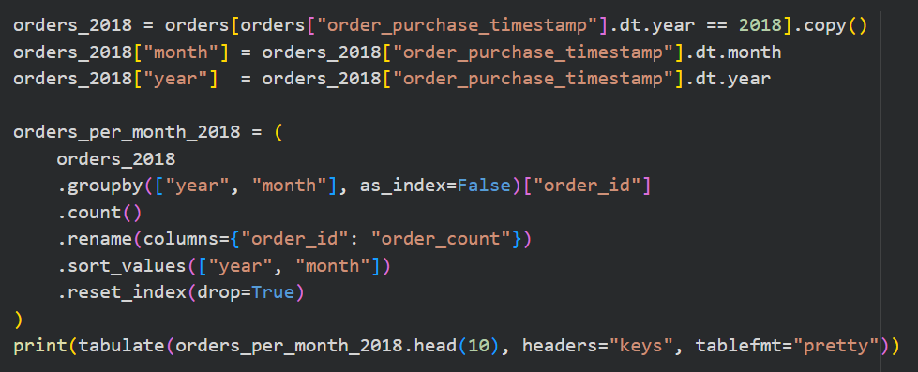
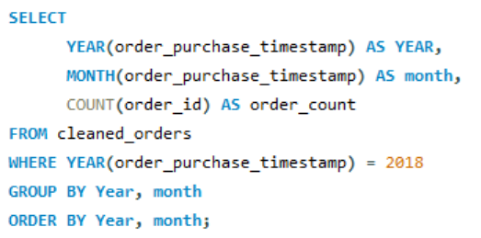
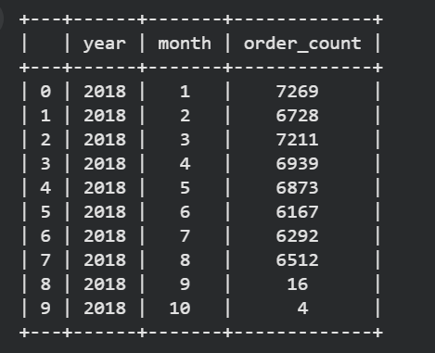
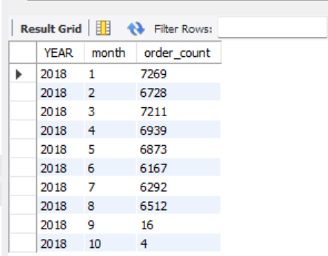
INTERMEDIATE PROBLEMS
Question 01
Calculate the number of orders per month in 2018
Python Code
SQL Query

Slide 8
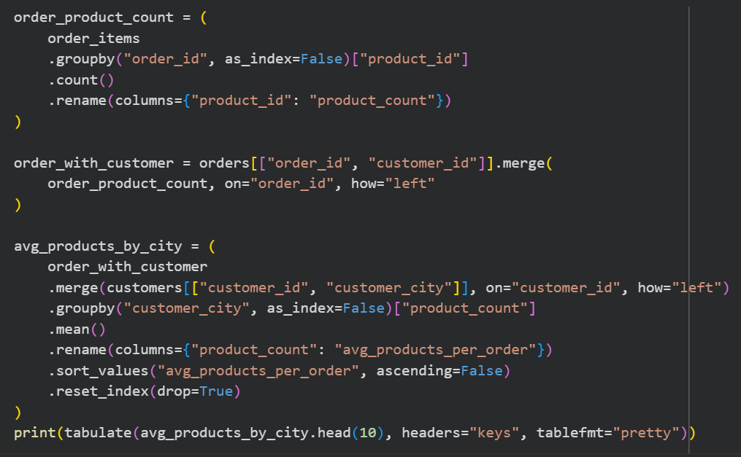
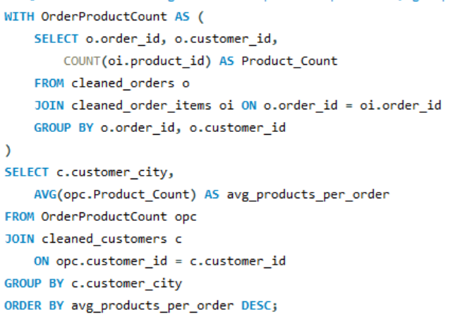
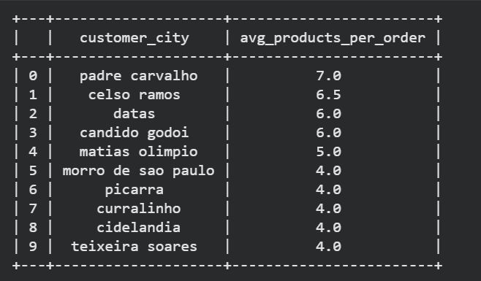
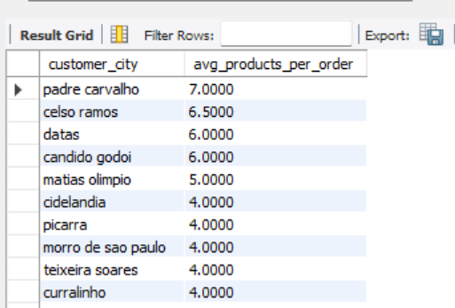
Question 02
Find the average number of products per order, grouped by customer city
Python Code
SQL Query

Slide 9
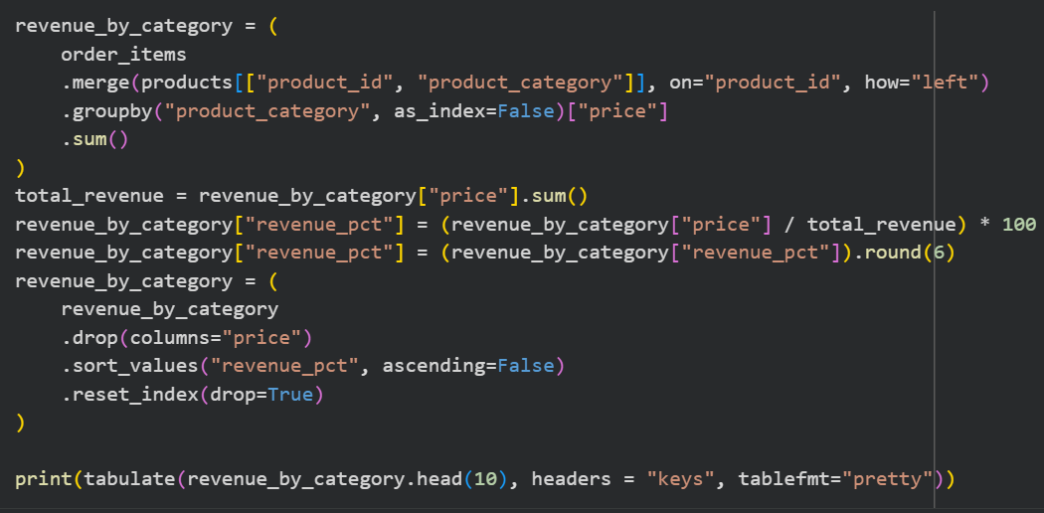
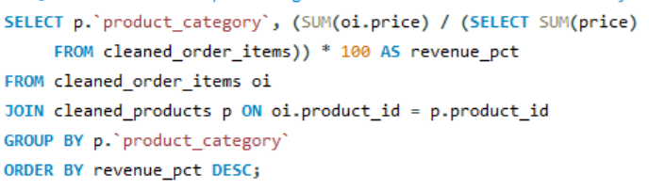
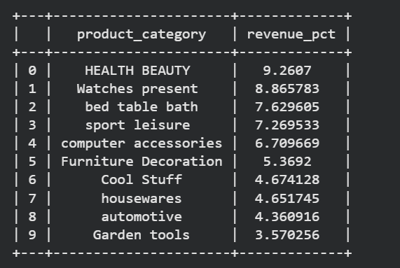
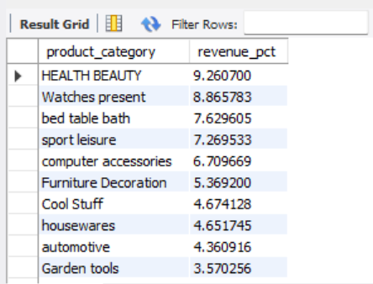
Question 03
Calculate the percentage of total revenue contributed by each product category
Python Code
SQL Query

Slide 10
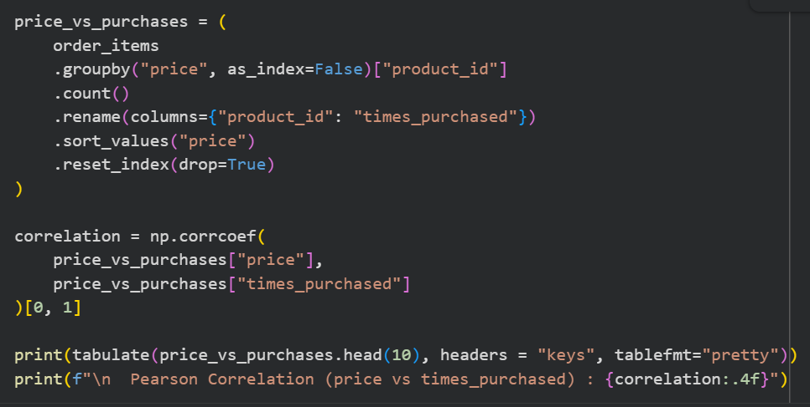
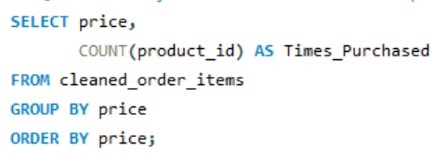
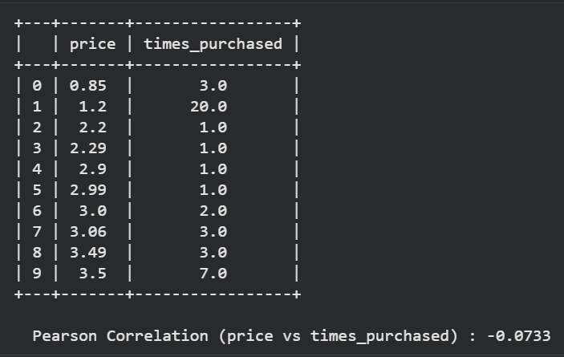
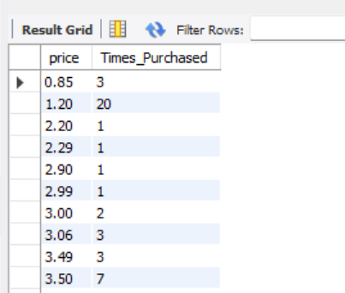
Question 04
Identify the correlation between product price and the number of times a product has been purchased
Python Code
SQL Query

Slide 11
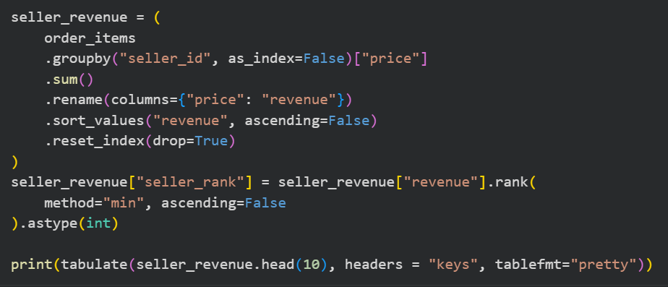
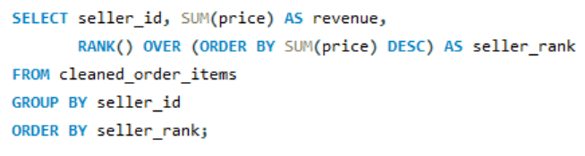
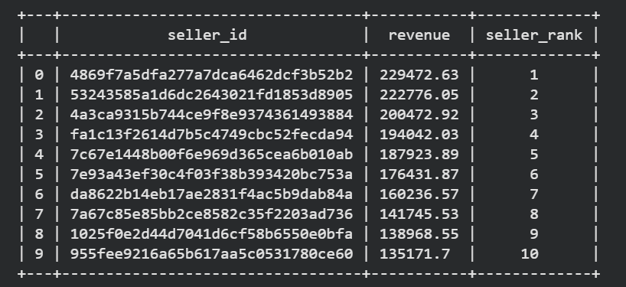
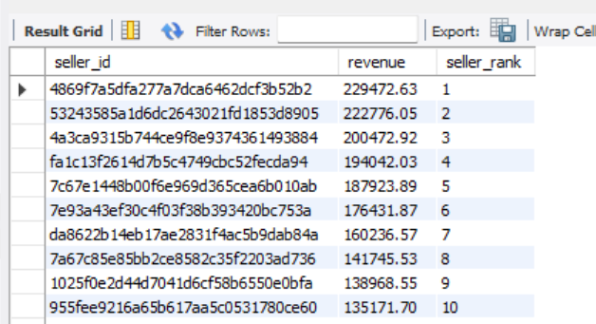
Question 05
Calculate the total revenue generated by each seller, and rank them by revenue
Python Code
SQL Query

Slide 12
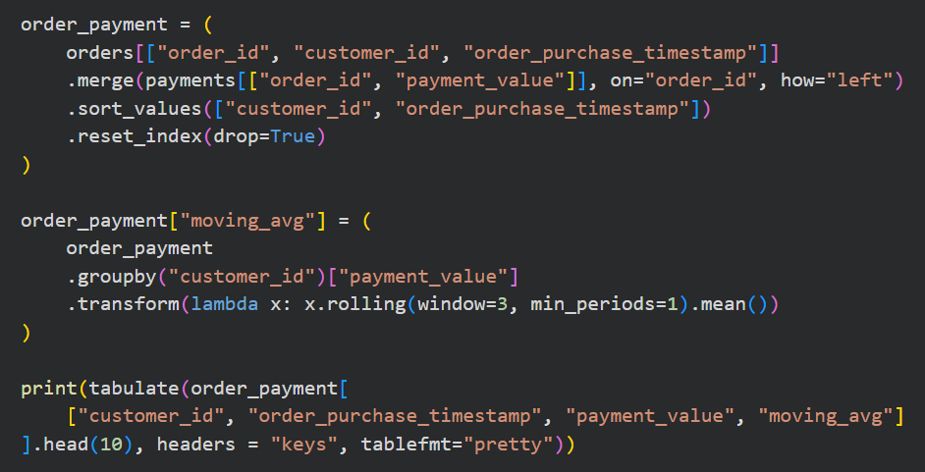
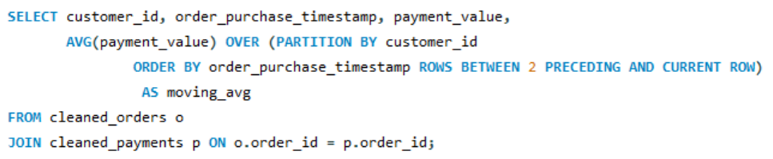
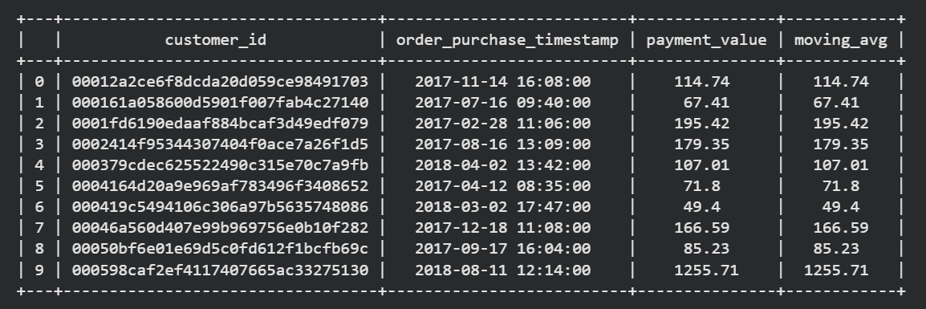
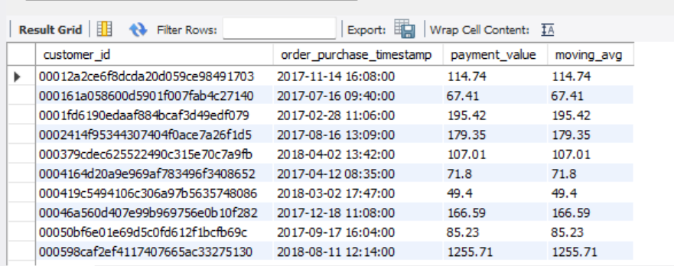
ADVANCED PROBLEMS
Question 01
Calculate the moving average of order values for each customer over their order history
Python Code
SQL Query

Slide 13
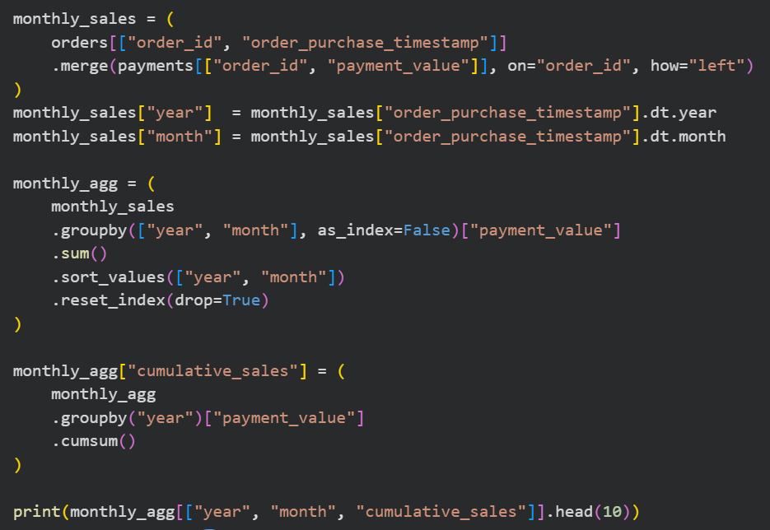
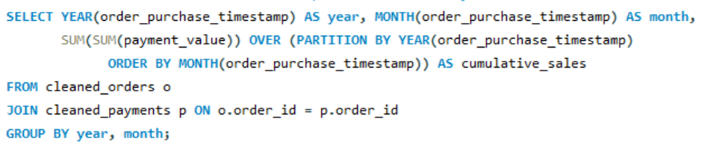
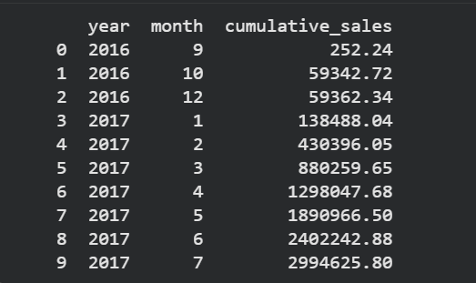
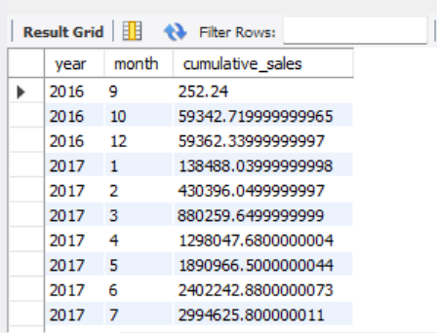
Question 02
Calculate the cumulative sales per month for each year
Python Code
SQL Query

Slide 14
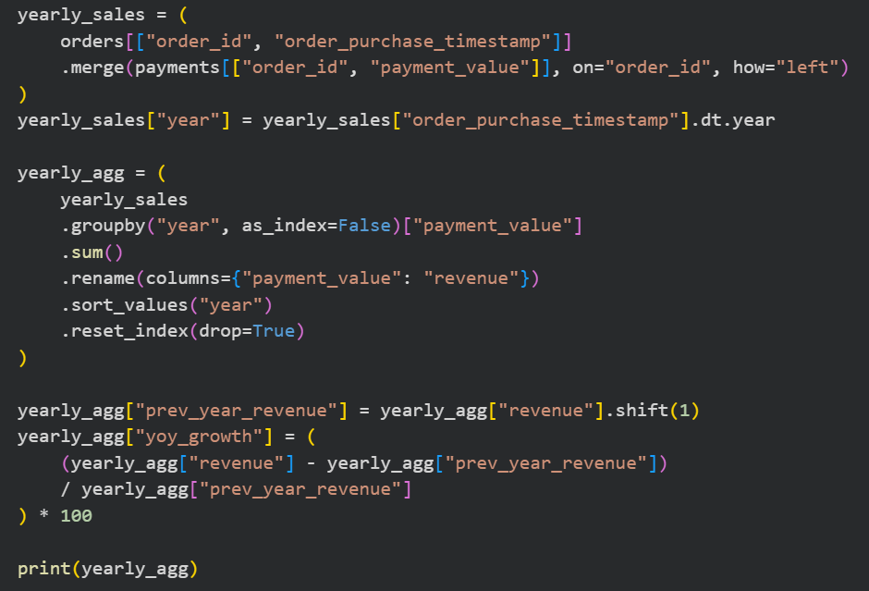
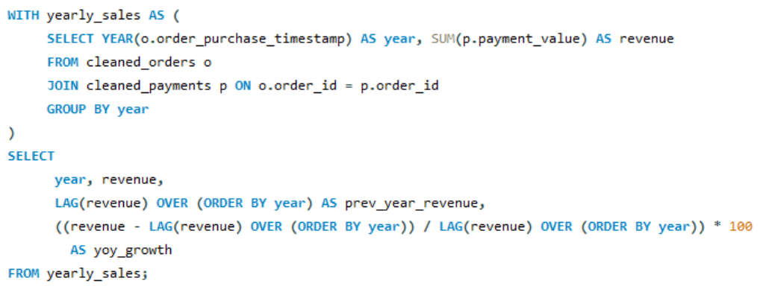
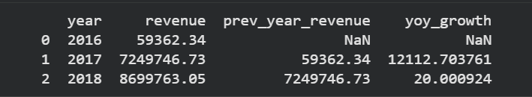
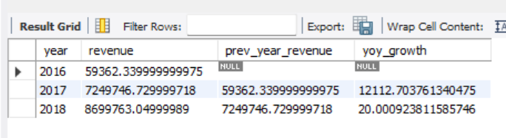
Question 03
Calculate the year-over-year growth rate of total sales
Python Code
SQL Query

Slide 15
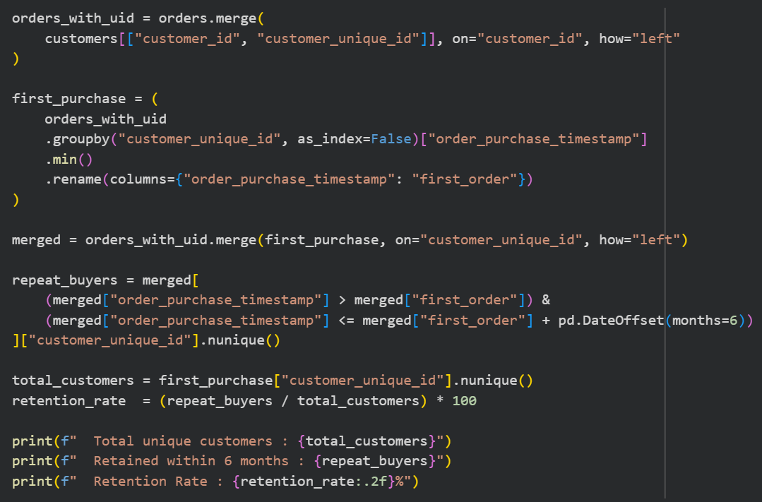



Question 04
Calculate the retention rate of customers, defined as the percentage of customers who make another purchase within 6 months of their first purchase
Python Code
SQL Query

Slide 16




Question 05
Identify the top 3 customers who spent the most money in each year
Python Code
SQL Query

